Slide 1
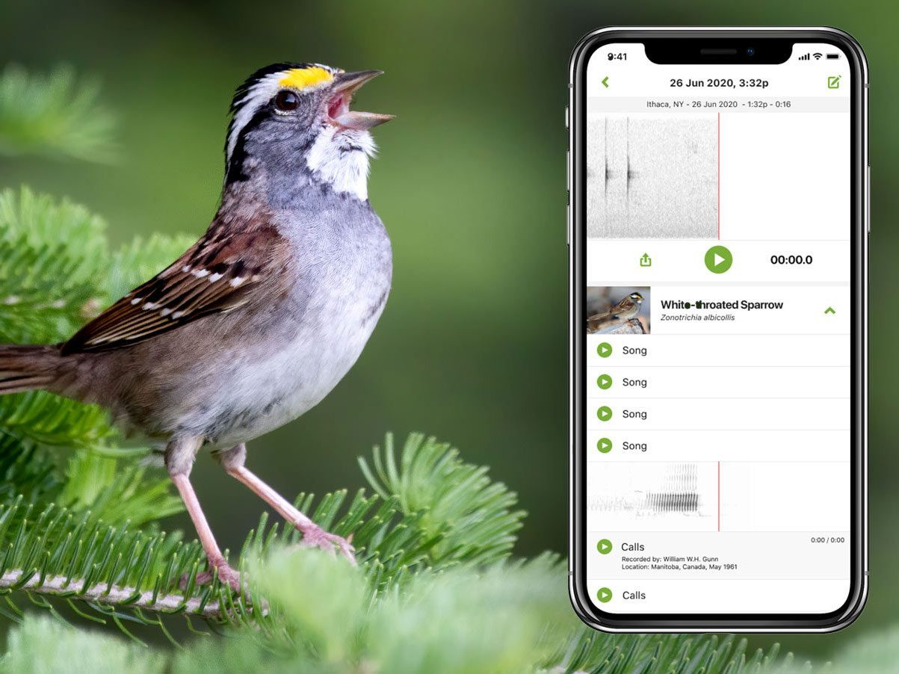
On-Device Bird Audio Recognition
Edge Impulse + Arduino Nano 33 BLE
Presenter 1: Kun Lu
Presenter 2: Haizhou Yu
Presenter 3: Haochen Liu

Slide 2
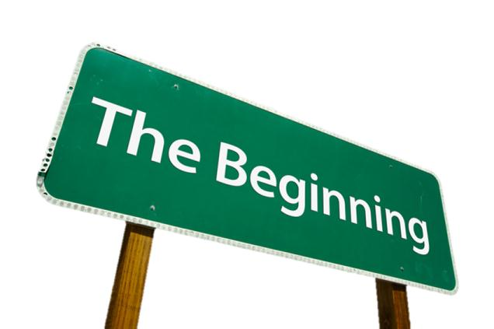
Introduction
Goal: build a TinyML audio classifier that distinguishes spoken digits as proxy for bird calls.
Dataset: Free Spoken Digit Dataset (FSDD, digits 0–9 at 8 kHz).
Platform: Arduino Nano 33 BLE Rev2 with on-board microphone.
Toolchain: Edge Impulse for data pipeline, model training, and deployment.
Focus: trade-offs between accuracy, latency, and memory on constrained AI hardware.

Slide 3
Motivation
Bird (or bird-like) audio carries information about biodiversity and environment.
On-device inference avoids streaming raw audio to the cloud (privacy, bandwidth, reliability).
Microcontroller constraints force hardware-aware ML design rather than cloud-style models.
Educational value: hands-on TinyML example from dataset → model → MCU deployment.

Slide 4


Motivation-Cont.
Bird identification is
Educational
Recreational
Convenient
Bird observing community/outdoor people
Anyone, wide use case

Slide 5
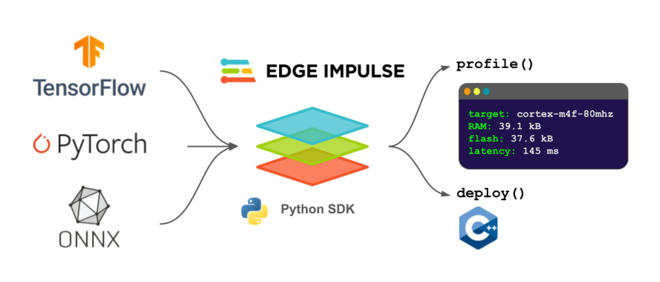
Methodology I – Edge Impulse Pipeline
Ingest FSDD audio and assign labels (digits 0–9 as bird classes).
Configure MFCC / log-mel signal processing block with MCU-friendly feature size.
Design a small neural network for audio classification in Edge Impulse Studio.
Train, validate, and quantize the model to INT8 for TinyML deployment.
Export the model as an Arduino library (Bird-Sound_inferencing.h + C++ runtime).

Slide 6
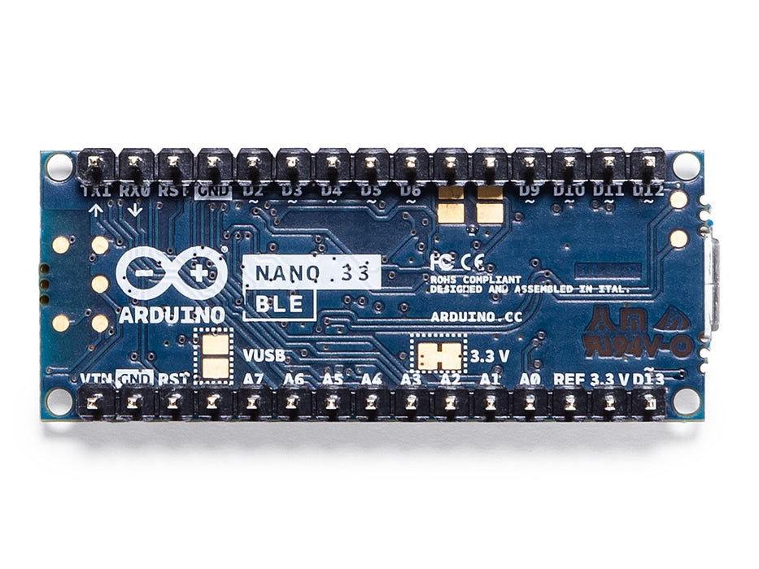
Methodology II – Arduino Nano 33 BLE Rev2
Import the Edge Impulse Arduino library and include Bird-Sound_inferencing.h.
Initialize serial, PDM microphone, and inference buffer in setup().
Use PDM callback to fill an int16_t buffer with live microphone samples.
In loop(), wrap samples into signal_t and call run_classifier() on the device.
Print predicted class probabilities and timing info over the serial monitor.

Slide 7
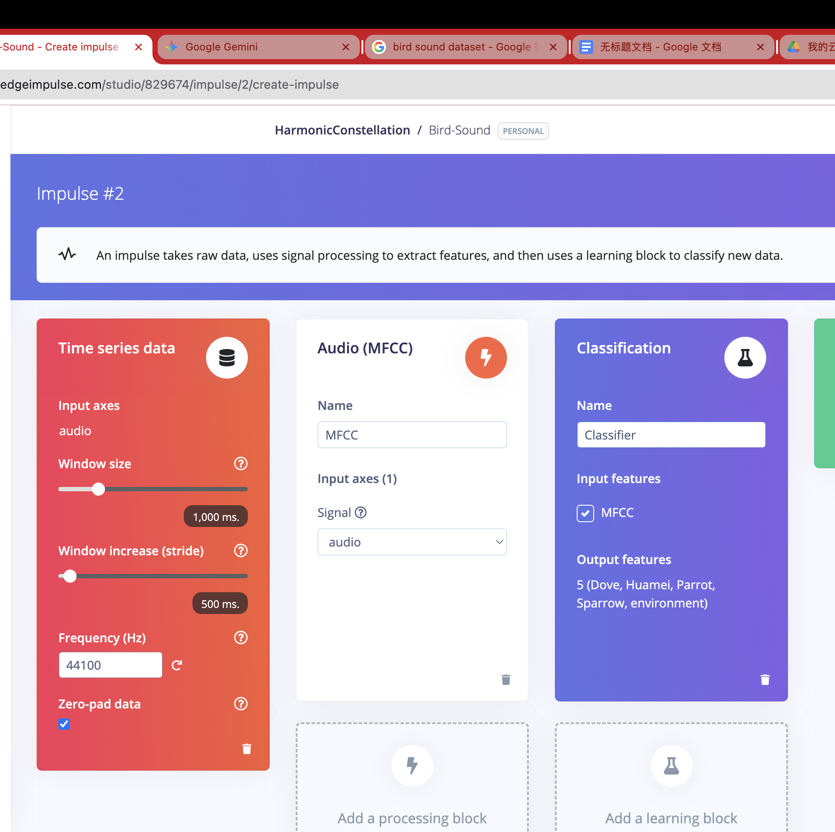
Data Strategy: Impulse Design
Target Classes: Dove, Huamei, Parrot, Sparrow
Negative Class: Environment (Robust background noise)
Time Series Settings:
- Window Size: 1000 ms (Captures full call)
- Window Increase: 500 ms (Overlap for onset detection) - Frequency: 44.1 kHz

Slide 8
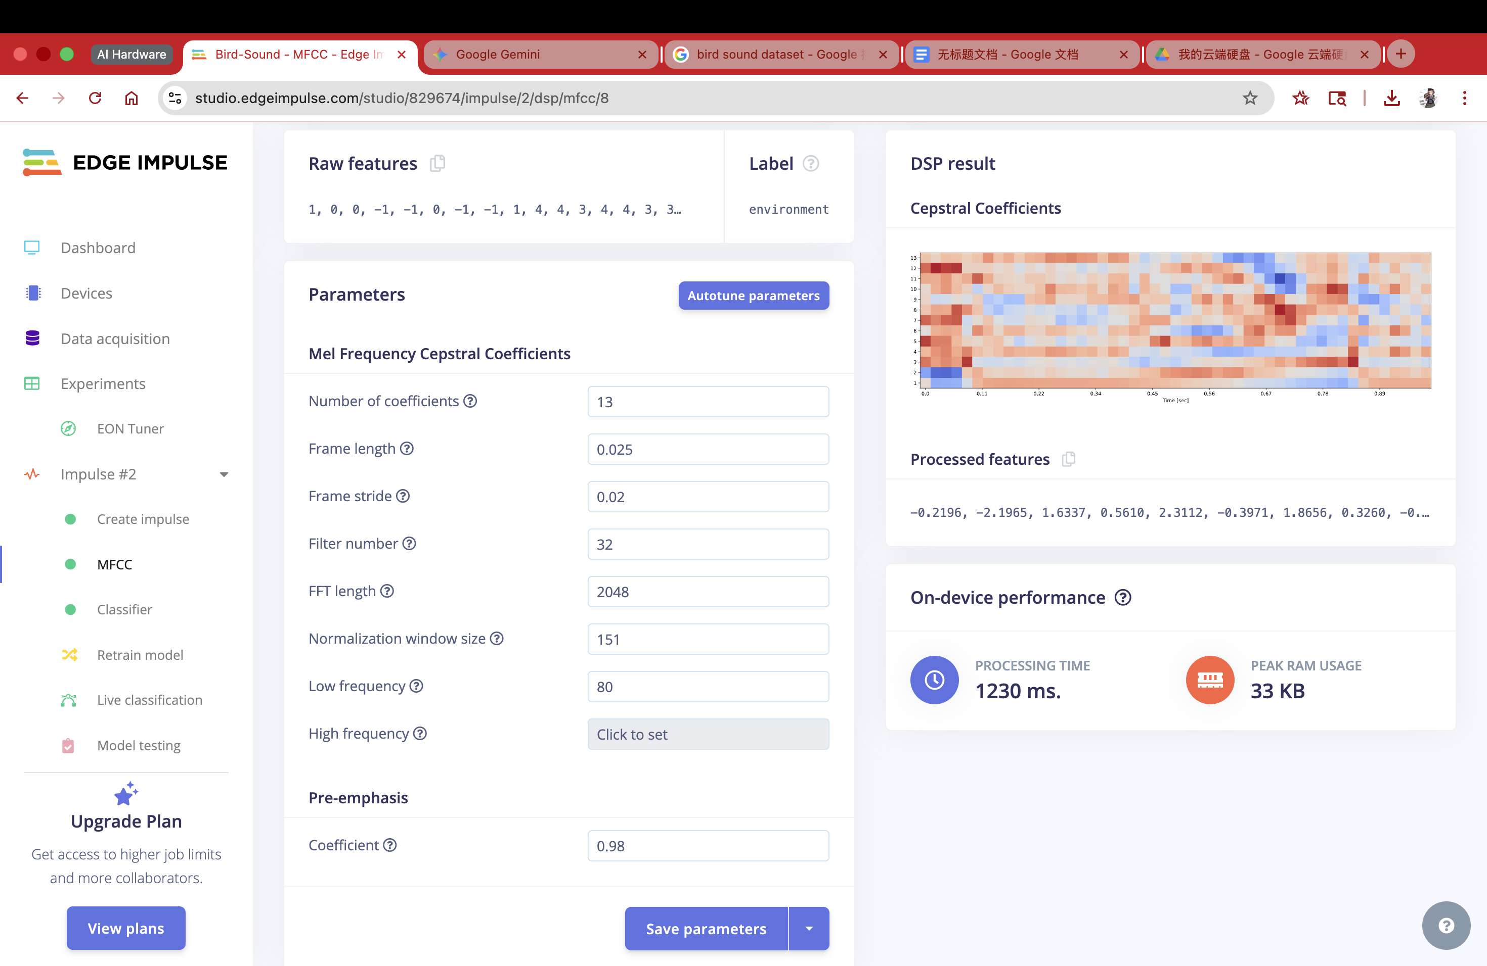
Feature Extraction: MFCC
Method: Mel Frequency Cepstral Coefficients (MFCC)
Parameters:
- Frame length: 0.025, Stride: 0.02
- Coefficients: 13, Filter number: 32
Why MFCC?
- Mimics biological hearing perception
- Separates high-freq bird chirps from low-freq noise

Slide 9
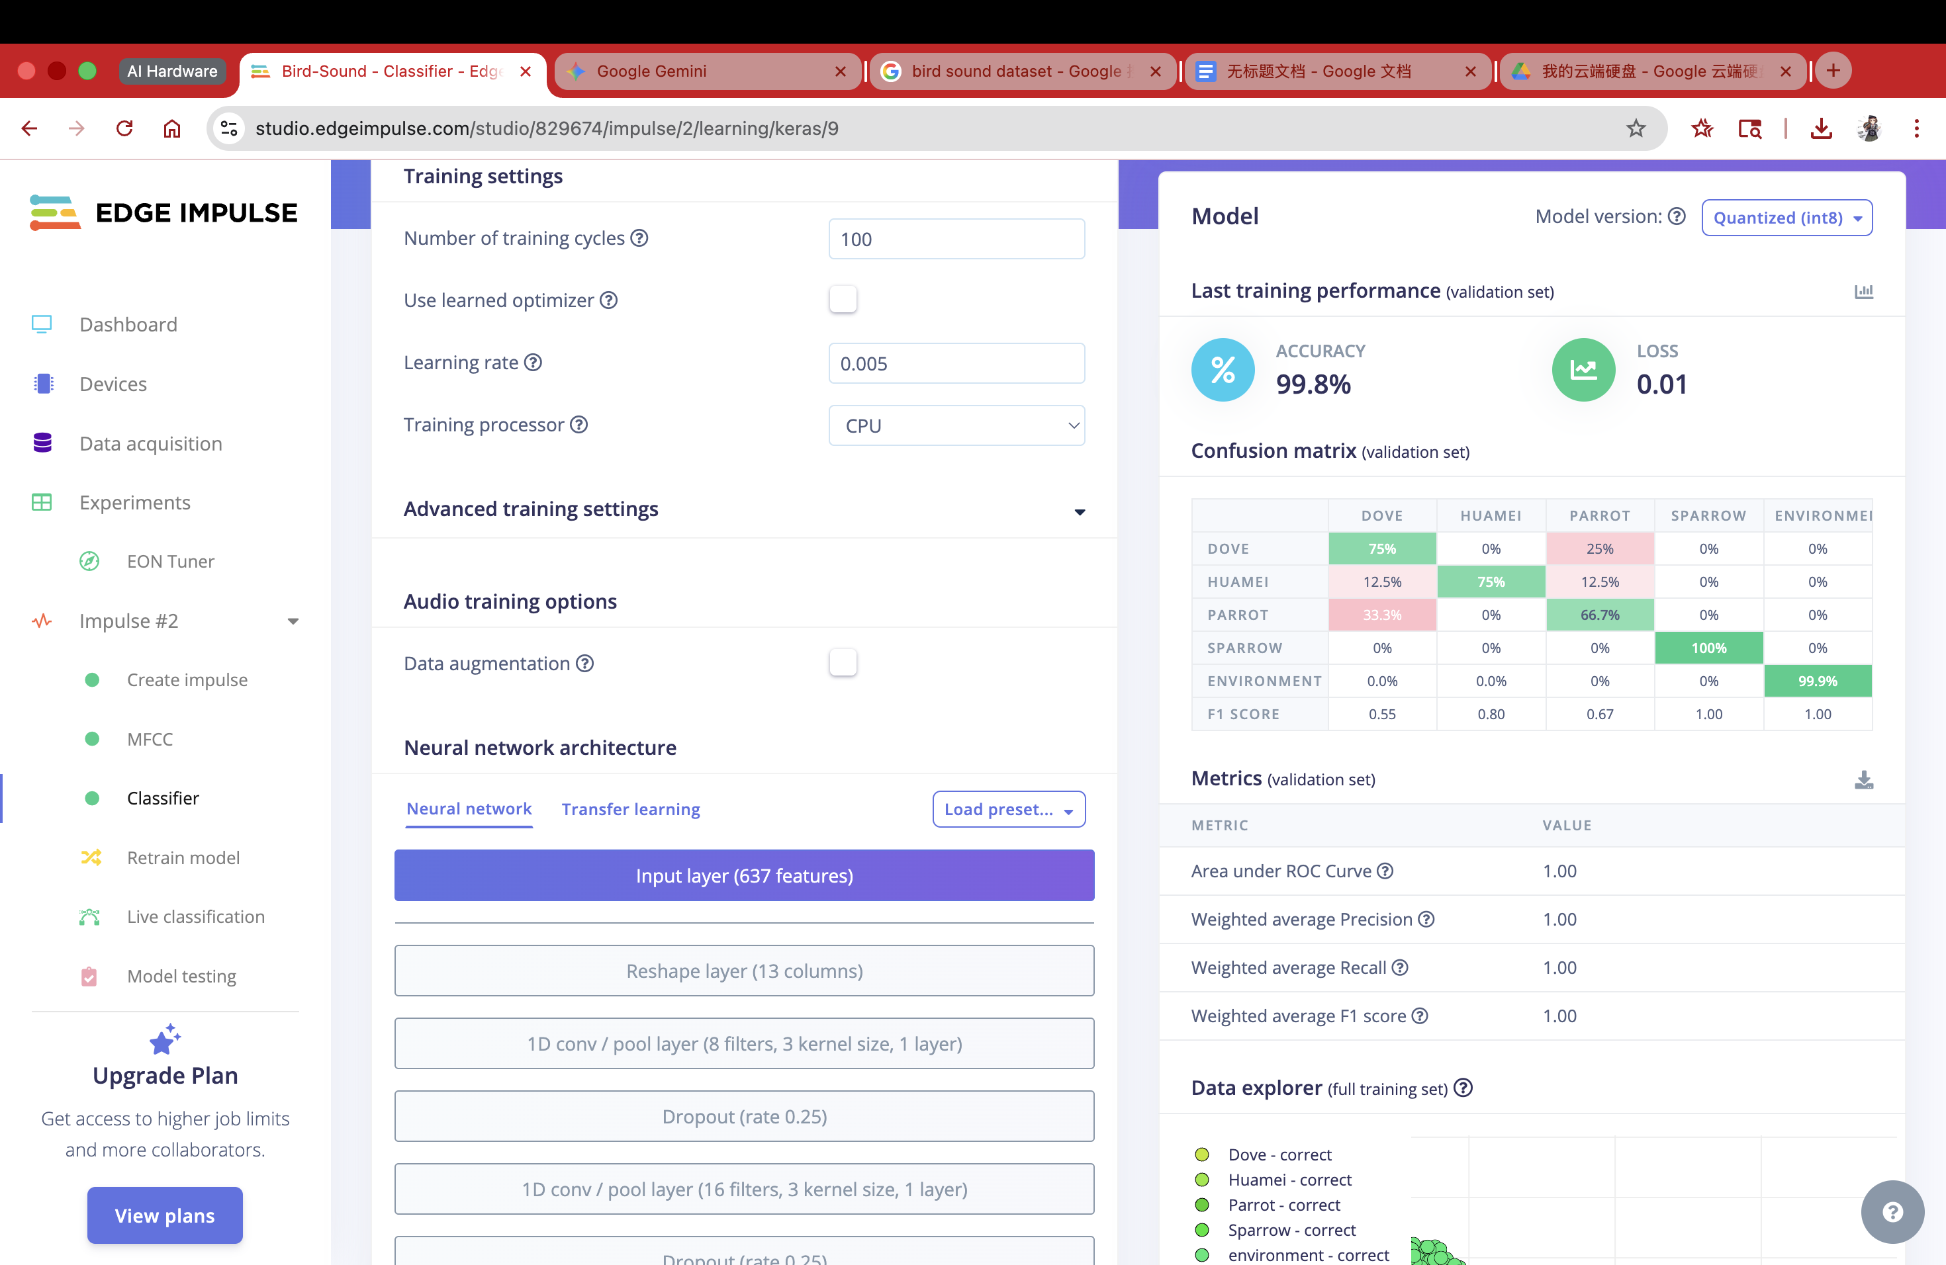
Neural Network Architecture
Input Features: 637 features
Model Structure: 1D Convolutional Neural Network (CNN)
- Layer 1: 8 filters, kernel size 3
- Layer 2: 16 filters, kernel size 3
Regularization:
- Dropout Layers (rate 0.25) to prevent overfitting
Training Config: 100 Epochs, Learning Rate 0.005

Slide 10
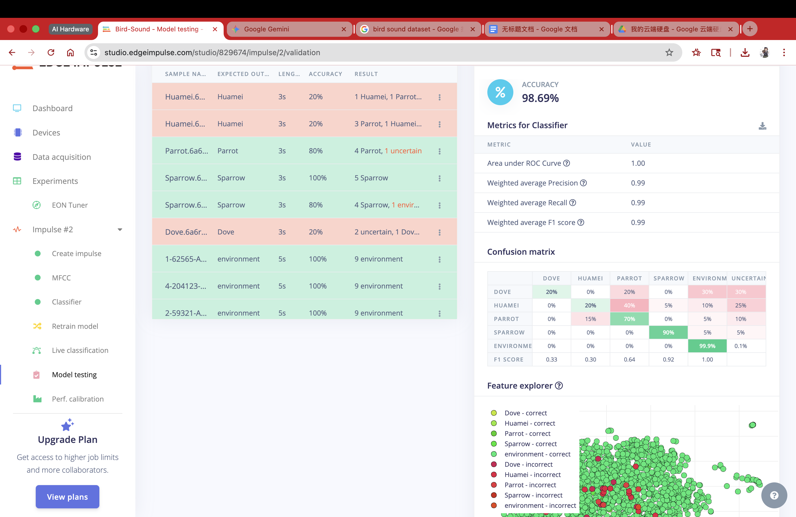
Model Performance Results
Training Accuracy: 99.8% | Loss: 0.01
Testing Accuracy (Unseen Data): 98.69%
Key Insights:
- Environment: ~100% accuracy (Low False Positive Rate)
- Sparrow: 100% detection rate
- Note: Minor confusion between Parrot/Dove (spectrally similar)

Slide 11
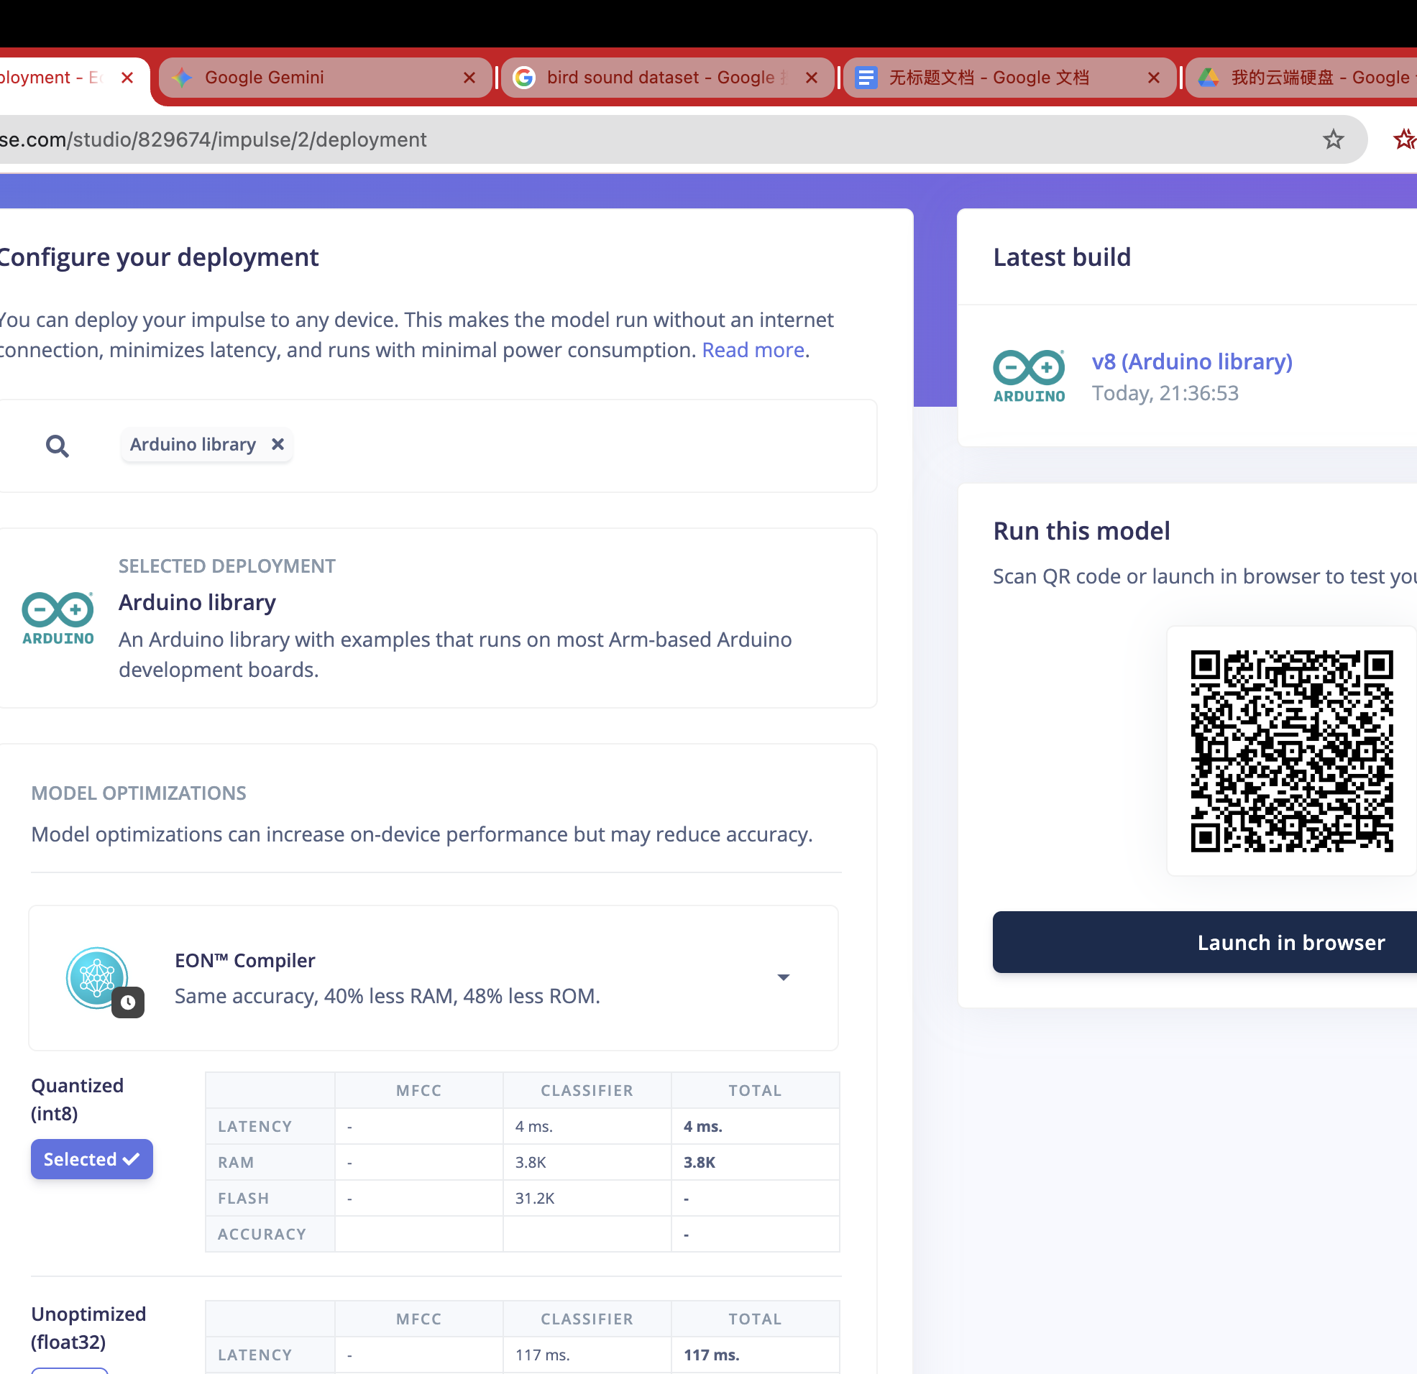
Deployment on Arduino Nano 33 BLE Sense
Optimization: EON™ Compiler + Int8 Quantization
On-Device Performance Estimates:
- Inference Time: 4 ms (Real-time capability)
- RAM Usage: 3.8 KB
- Flash Usage: 31.2 KB
Outcome: Generated optimized Arduino Library

Slide 12
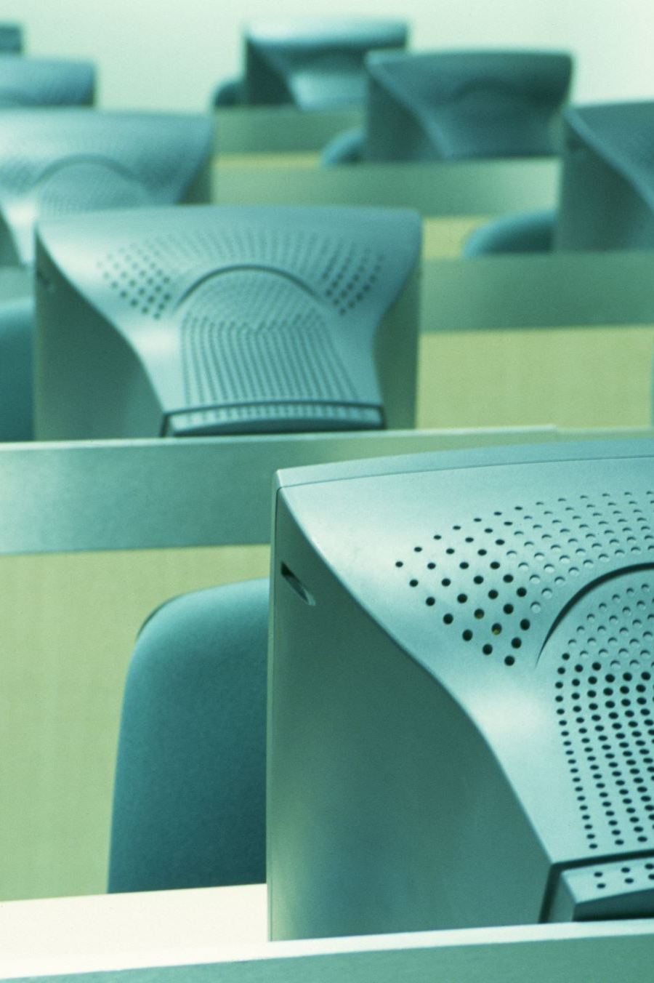
Implementation
Using Arduino IDE
Import library
Built-in code for deployment:
Reads Microphone through a time window
Match with model
Provides results through the serial output back to PC

Slide 13
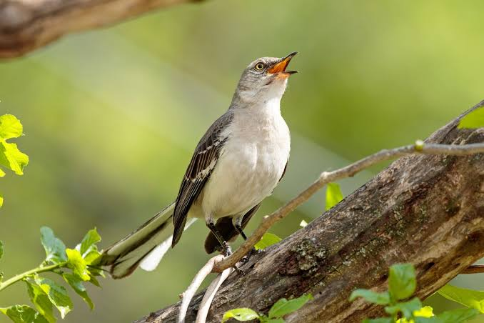
Hardware Limitation: Nano 33 BLE Rev2 Microphone Issue
expectation: use on-board microphone as live audio input.
Our kit: Arduino Nano 33 BLE Rev2, not the original Rev1.
Edge Impulse Arduino examples and PDM config are tuned for Rev1 audio path.
On Rev2 the exported code compiles, but microphone access is unreliable.
We determined this is a hardware/driver support issue, not a model problem.

Slide 14
Workaround: File-Based Bird Audio Recognition
Switched from live mic input to file-based input to keep progress.
Users upload WAV files (FSDD samples) as proxy bird-audio examples.
Reuse the same Edge Impulse model and MFCC-based feature pipeline.
Run inference on uploaded files instead of streaming PDM audio.
Trade-off: no true live listening, but full TinyML pipeline is still demonstrated.

Slide 15
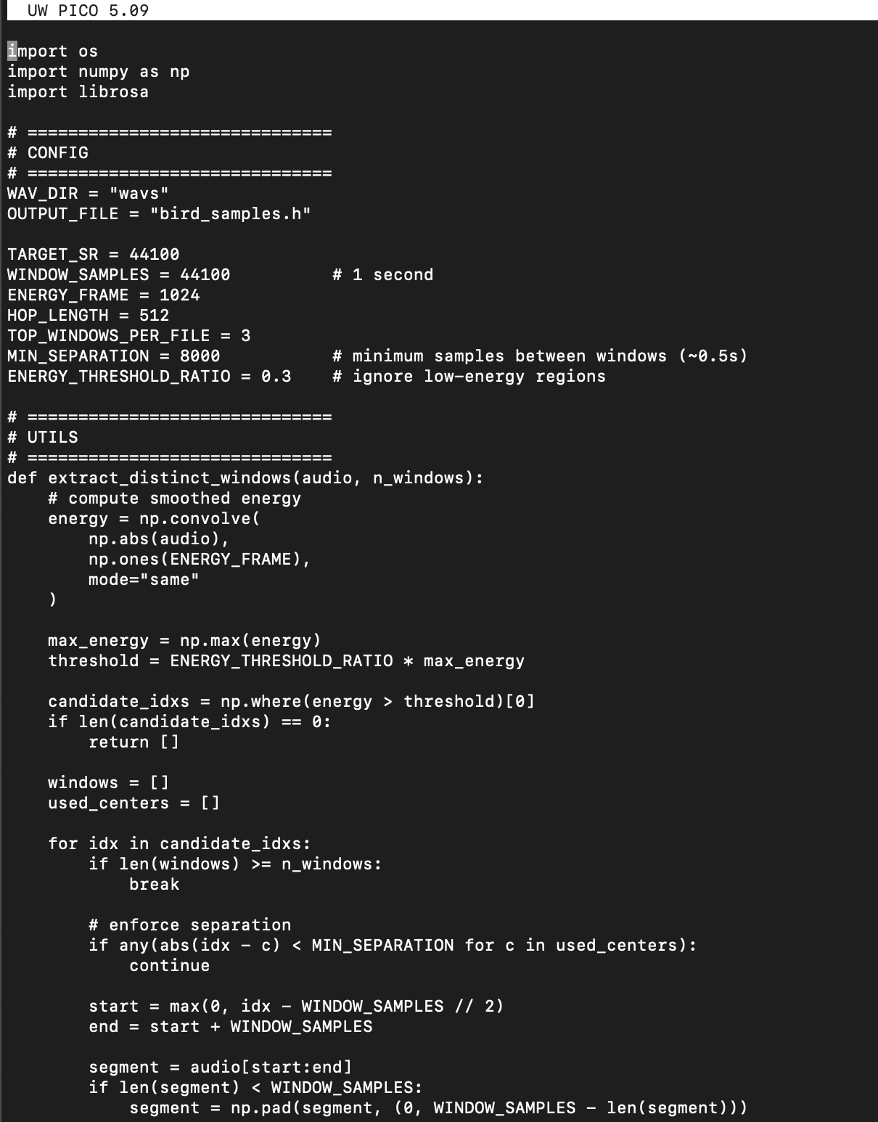

File-Based: Python Helper Program
Overall Responsibilities of the Python Helper
Prepare WAV files for embedded inference
Ensure sample rate, length, and format match the trained model
Automatically extract meaningful audio segments
Generate a C header file usable directly by Arduino

Slide 16

File-Based: Python Helper Program
Step 1: Audio Loading & Resampling
Load WAV files using librosa
Convert all audio to:
Mono
Target sample rate (e.g. 44.1 kHz)
Normalize amplitude to [-1, 1]
This guarantees consistency with the Edge Impulse impulse
Step 2: Energy-Based Signal Analysis
Compute short-time signal energy using:
Absolute amplitude
Sliding window convolution
Energy highlights:
Bird calls
Chirps
Acoustic events
Silence and background are naturally suppressed
Step 3: Distinct Window Extraction (Key Innovation)
Identify high-energy regions above a threshold
Enforce minimum separation between windows
Prevents duplicate windows from the same chirp
Extract multiple fixed-length windows per WAV:
Each window centered on a different acoustic event
This converts the file to multiple inference-ready samples
Step 4: Generate the C header file
Dependencies
User definitions (sample rate, audio clip numbers, etc.)
Metadata
Raw Audio Sample data

Slide 17
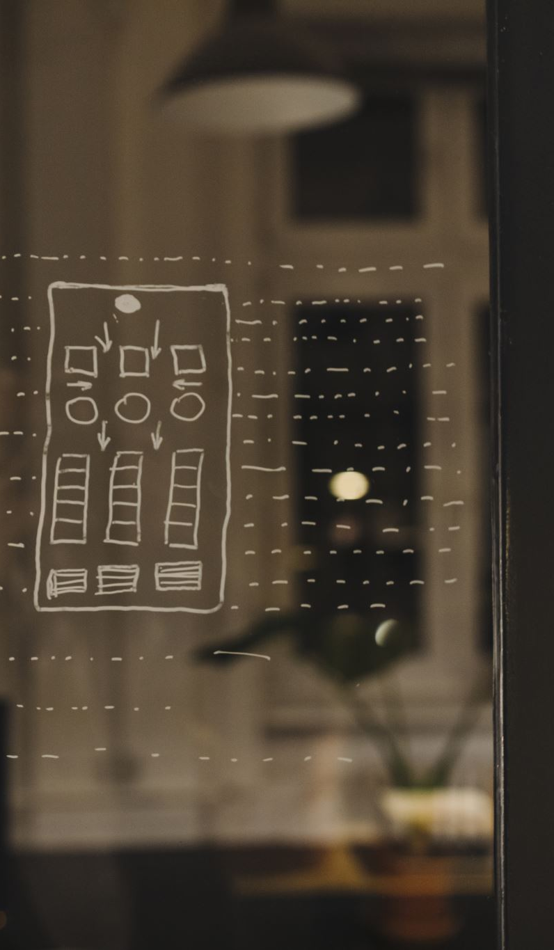
Problem faced
Key Problems:
Slow Compilation speeds, not real time
Low accuracy for each sample
The window seperation from last slide
SMALL FLASH SIZE -1MB
Cannot even process four clips at a time!!!
Separate testing, more tedious

Slide 18
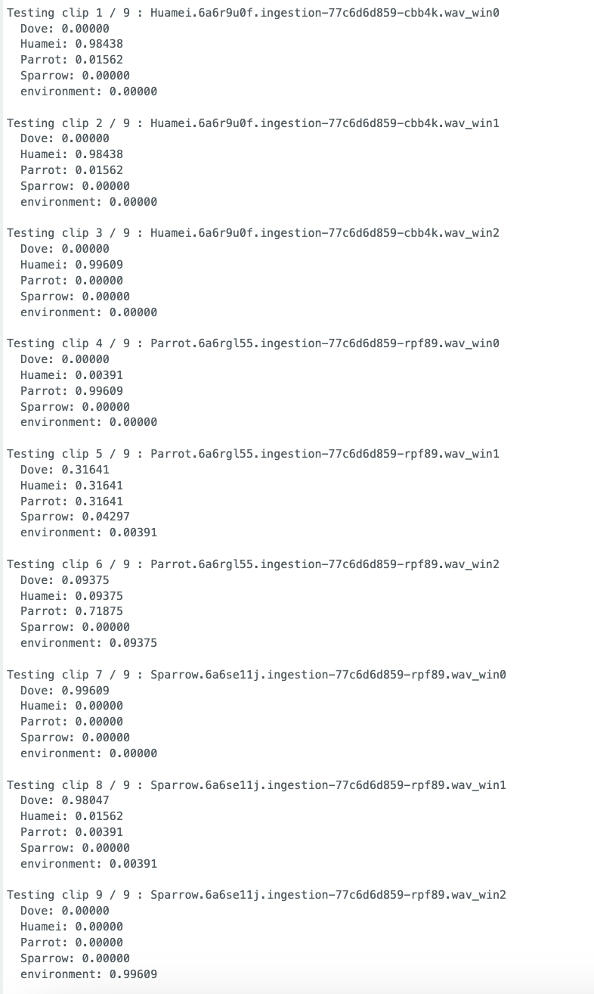
Results
Testing is forced to similify
Decent results when samples are windowed
Would be better if other MCUs used
Testing is limited due to time constrains and speed

